Slide 1

Chapter 2
Software Testing: A Craftsman’s Approach, 4th Edition Chapter 2 Examples
Examples

Slide 2
About Pseudo-code
Language neutral
Supports both procedural and object-oriented code
Easy to “translate” into your favorite programming language

Slide 3
Examples
Triangle problem
NextDate
Commission problem
Simple ATM system
Currency converter
Windshield Wiper controller
Garage door controller

Slide 4
Triangle Problem
Simple version: The triangle program accepts three integers, a, b, and c, as input. These are taken to be sides of a triangle. The output of the program is the type of triangle determined by the three sides: Equilateral, Isosceles, Scalene, or Not A Triangle.
Improved version: “Simple version” plus better definition of inputs:
The integers a, b, and c must satisfy the following conditions:
c1. 1 ≤ a ≤ 200 c4. a < b + c
c2. 1 ≤ b ≤ 200 c5. b < a + c
c3. 1 ≤ c ≤ 200 c6. c < a + b
Final Version: “Improved version” plus better definition of outputs:
If an input value fails any of conditions c1, c2, or c3, the program notes this with an output message, for example, “Value of b is not in the range of permitted values.” If values of a, b, and c satisfy conditions c1, c2, and c3, one of four mutually exclusive outputs is given:
1. If all three sides are equal, the program output is Equilateral.
2. If exactly one pair of sides is equal, the program output is Isosceles.
3. If no pair of sides is equal, the program output is Scalene.
4. If any of conditions c4, c5, and c6 is not met, the program output is NotATriangle.

Slide 5
Triangle Problem Discussion
Final Version: “Improved version” plus better definition of outputs:
If an input value fails any of conditions c1, c2, or c3, the program notes this with an output message, for example, “Value of b is not in the range of permitted values.” If values of a, b, and c satisfy conditions c1, c2, and c3, one of four mutually exclusive outputs is given:
  1. If all three sides are equal, the program output is Equilateral.
  2. If exactly one pair of sides is equal, the program output is Isosceles.
  3. If no pair of sides is equal, the program output is Scalene.
  4. If any of conditions c4, c5, and c6 is not met, the program output is NotATriangle.
Problems persist! What output is expected for the input set (2, 2, 5)?
  Isosceles because a = b?
  NotATriangle because c > a+b?

Slide 6
Triangle Problem Exercise
Fix the “Final Version” (sometimes testers must also be specifiers!)
The Really Final Version: “Improved version” plus better definition of outputs.

Slide 7
NextDate
NextDate is a function of three variables: month, date, and year. It returns the date of the day after the input date. The month, date, and year variables have integer values subject to these conditions:
c1. 1 ≤ month ≤12
c2. 1 ≤ day ≤ 31
c3. 1812 ≤ year ≤ 2012
If any of conditions c1, c2, or c3 fails, NextDate produces an output indicating the corresponding variable has an out-of-range value — for example, “Value of month not in the range 1..12”. Because numerous invalid day–month–year combinations exist, NextDate collapses these into one message: “Invalid Input Date.”

Slide 8
The Commission Problem
A rifle salesperson in the former Arizona Territory sold rifle locks, stocks, and barrels made by a gunsmith in Missouri. Locks cost $45, stocks cost $30, and barrels cost $25. The salesperson had to sell at least one complete rifle per month, and production limits were such that the most the salesperson could sell in a month was 70 locks, 80 stocks, and 90 barrels. After each town visit, the salesperson sent a telegram to the Missouri gunsmith with the number of locks, stocks, and barrels sold in that town. At the end of a month, the salesperson sent a very short telegram showing –1 locks sold. The gunsmith then knew the sales for the month were complete and computed the salesperson’s commission as follows: 10% on sales up to (and including) $1000, 15% on the next $800, and 20% on any sales in excess of $1800. The commission program produced a monthly sales report that gave the total number of locks, stocks, and barrels sold, the salesperson’s total dollar sales, and, finally, the commission.

Slide 9
The Simple ATM (SATM) System
Deliberately simple (only 15 screens)
Very familiar example
Full description in text

Slide 10
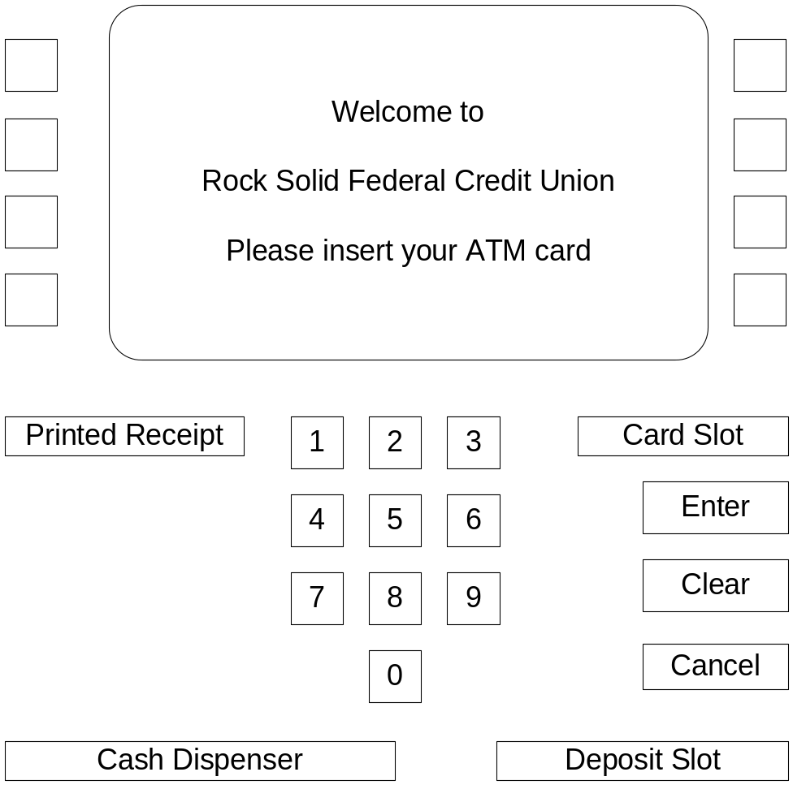
The Simple ATM (SATM) Terminal

Slide 11
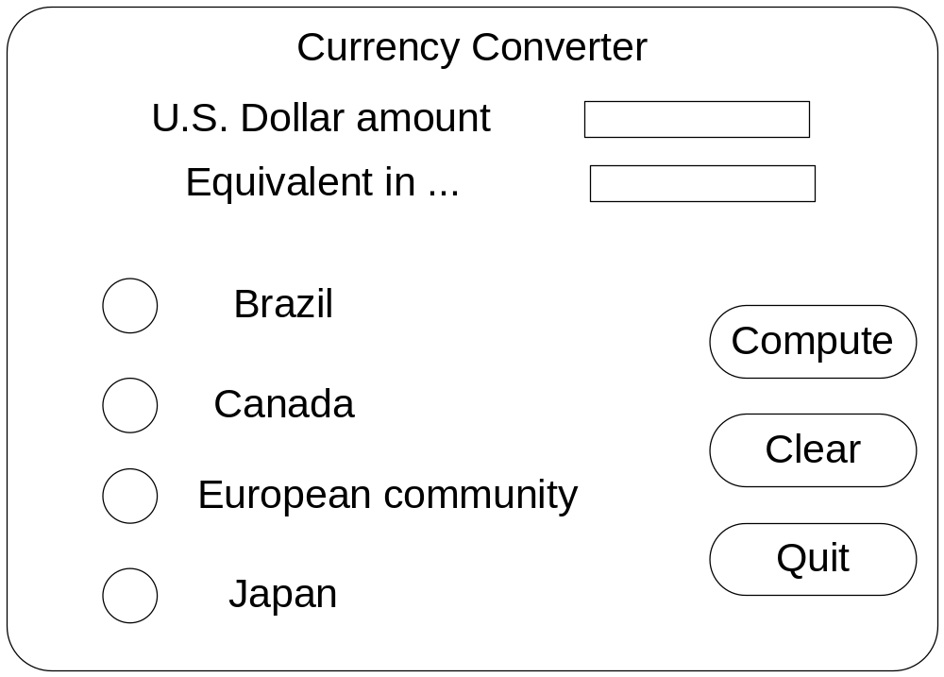
The Currency Converter
The currency conversion program is another event-driven program that emphasizes code associated with a graphical user interface (GUI).

Slide 12
The Saturn Windshield Wiper Controller
The windshield wiper on some Saturn automobiles is controlled by a lever with a dial. The lever has four positions, OFF, INT (for intermittent), LOW, and HIGH, and the dial has three positions, numbered simply 1, 2, and 3. The dial positions indicate three intermittent speeds, and the dial position is relevant only when the lever is at the INT position. The decision table below shows the windshield wiper speeds (in wipes per minute) for the lever and dial positions.
c1. Lever | OFF | INT | INT | INT | LOW | HIGH
c2. Dial | n/a | 1 | 2 | 3 | n/a | n/a
a1. Wiper speed is… | 0 | 4 | 6 | 12 | 30 | 60

Slide 13
The Garage Door Controller
This is an example for Systems of Systems
Constituent systems
  a drive motor
  a drive chain
  the garage door wheel tracksensors
  a lamp
  an electronic controller
Communication devices
  wireless keypad (usually in an automobile)
  a digit keypad on the outside of the garage door
  a wall-mounted button.
Safety features
  a light beam near the floor
  an obstacle sensor

Slide 14
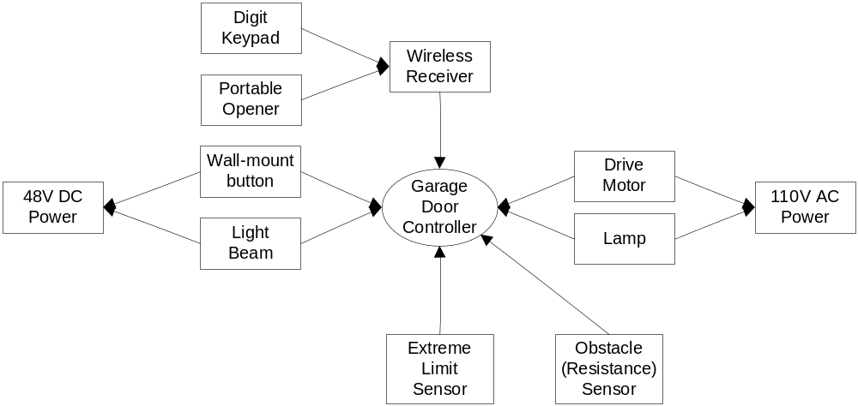
The Garage Door Controller
(shown here as a SysML Context Diagram)

